Slide 1
The Poincaré Conjecture & Perelman’s Solution
Boris Li
Mentor: Stephen Gustafson

Slide 2
1904

Slide 3
Every simply connected,
closed 3-manifold
is homeomorphic
to the 3-sphere.
Milnor, J. (2004, June). The Poincaré Conjecture. https://www.claymath.org/sites/default/files/poincare.pdf

Slide 4
Every simply connected,
closed 3-manifold
is homeomorphic
to the 3-sphere.
Lee, J. M. (2012). Introduction to Smooth Manifolds (2nd ed.). Springer.

Slide 5
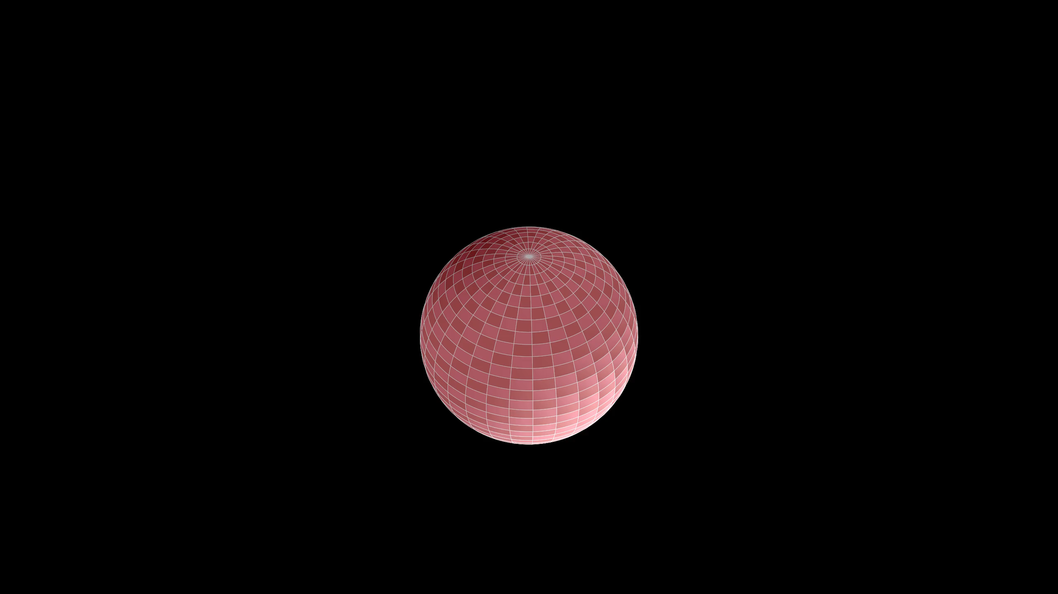

Slide 6
Every simply connected,
closed 3-manifold
is homeomorphic
to the 3-sphere.

Slide 7
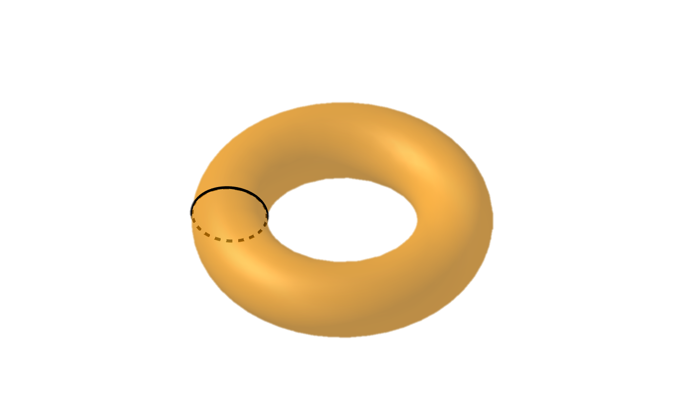

Slide 8
Every simply connected,
closed 3-manifold
is homeomorphic
to the 3-sphere.

Slide 9


Slide 10
Every simply connected,
closed 3-manifold
is homeomorphic
to the 3-sphere.
Lee, J. M. (2011). Introduction to Topological Manifolds (2nd ed.). Springer..

Slide 11
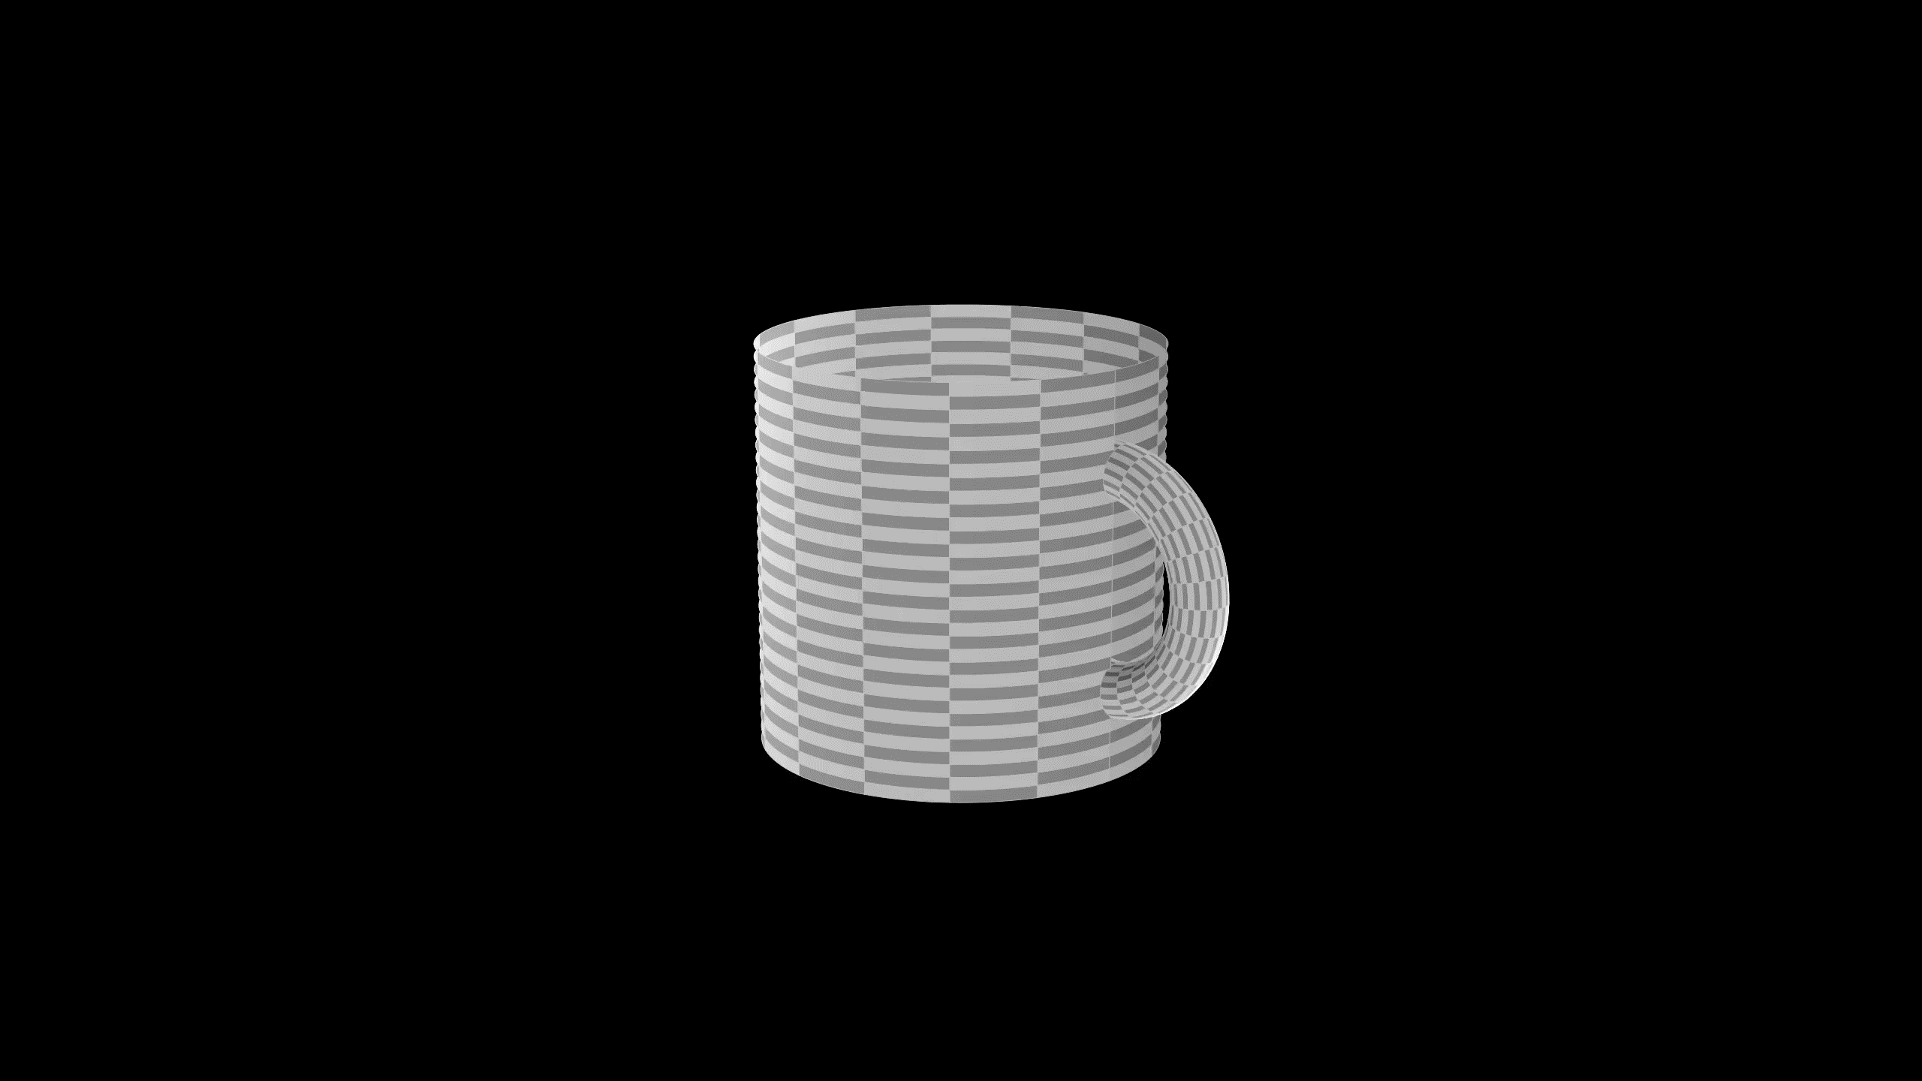

Slide 12
Every simply connected,
closed 3-manifold
is homeomorphic
to the 3-sphere.

Slide 13
Every simply connected,
closed 3-manifold
is homeomorphic
to the 3-sphere.
Milnor, J. (2004, June). The Poincaré Conjecture. https://www.claymath.org/sites/default/files/poincare.pdf

Slide 14

Generalized Poincaré Conjecture
$$n=1, 2$$ | trivial
$$n≥7$$ | 1960
$$n≥5$$ | 1962
$$n=4$$ | 1982
$$n=3$$ | ?
Milnor, J. (2004, June). The Poincaré Conjecture. https://www.claymath.org/sites/default/files/poincare.pdf

Slide 15
P vs NP
Hodge Conjecture
Riemann Hypothesis
Poincaré Conjecture
Yang-Mills Existence & Mass Gap
Navier-Stokes Existence & Smoothness
Birch & Swinnerton-Dyer Conjecture
Clay Math Institute. Millennium Problems. Retrieved from https://www.claymath.org/millennium-problems.

Slide 16
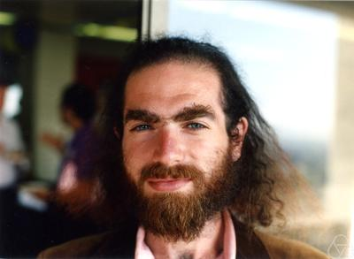
2002
upload.wikimedia.org/wikipedia/commons/4/43/Perelman%2C_Grigori_%281966%29.jpg

Slide 17
Ricci Flow
Surgery
Finite Extinction Time
Perelman, G. (2002, November 11). The entropy formula for the Ricci flow and its geometric applications. Retrieved from arXiv:math/0211159

Slide 20
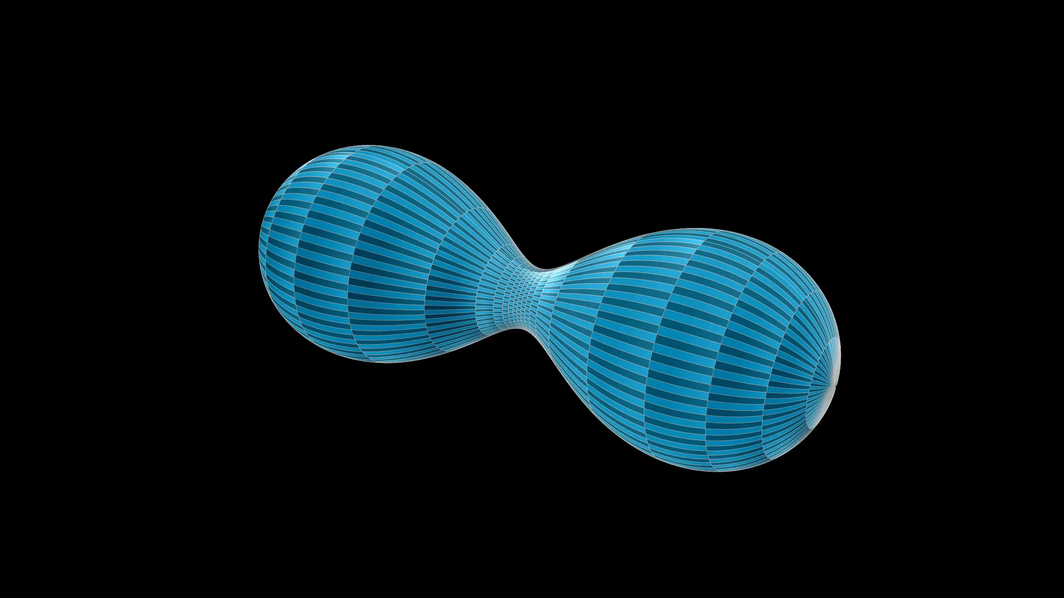

Slide 21
Ricci Flow
Surgery
Finite Extinction Time
Perelman, G. (2003, March 10). Ricci flow with surgery on three-manifolds. Retrieved from arXiv:math/0303109

Slide 22
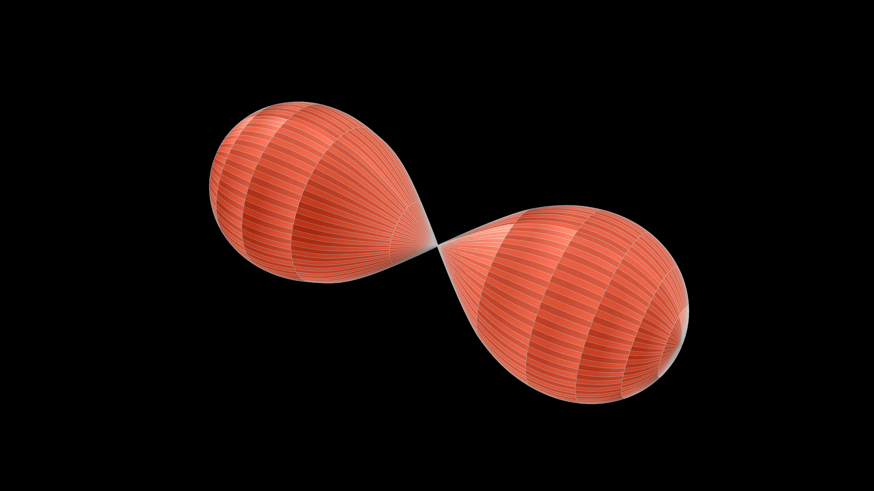

Slide 24
Ricci Flow
Surgery
Finite Extinction Time
Perelman, G. (2003, July 17). Finite extinction time for the solutions to the Ricci flow on certain three-manifolds. Retrieved from arXiv:math/0307245

Slide 25
P vs NP
Hodge Conjecture
Riemann Hypothesis
Poincaré Conjecture
Yang-Mills Existence & Mass Gap
Navier-Stokes Existence & Smoothness
Birch & Swinnerton-Dyer Conjecture
Clay Math Institute. Millennium Problems. Retrieved from https://www.claymath.org/millennium-problems.

